Slide 1
Cars’ Prices Prediction
By Edoardo Frigerio and Nicolò Obelleri

Slide 2
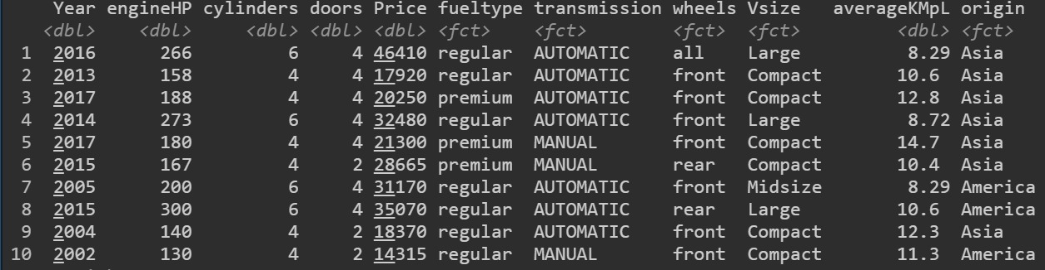
Dataset & Goals
Goals: to build a model able to predict the final price based on cars’ features.
To achieve our goal we will use three types of regression: Ridge, Lasso and Random Forest.
Dataset: collection of approximatly 7000 observations of second-hand cars’ features

Slide 3
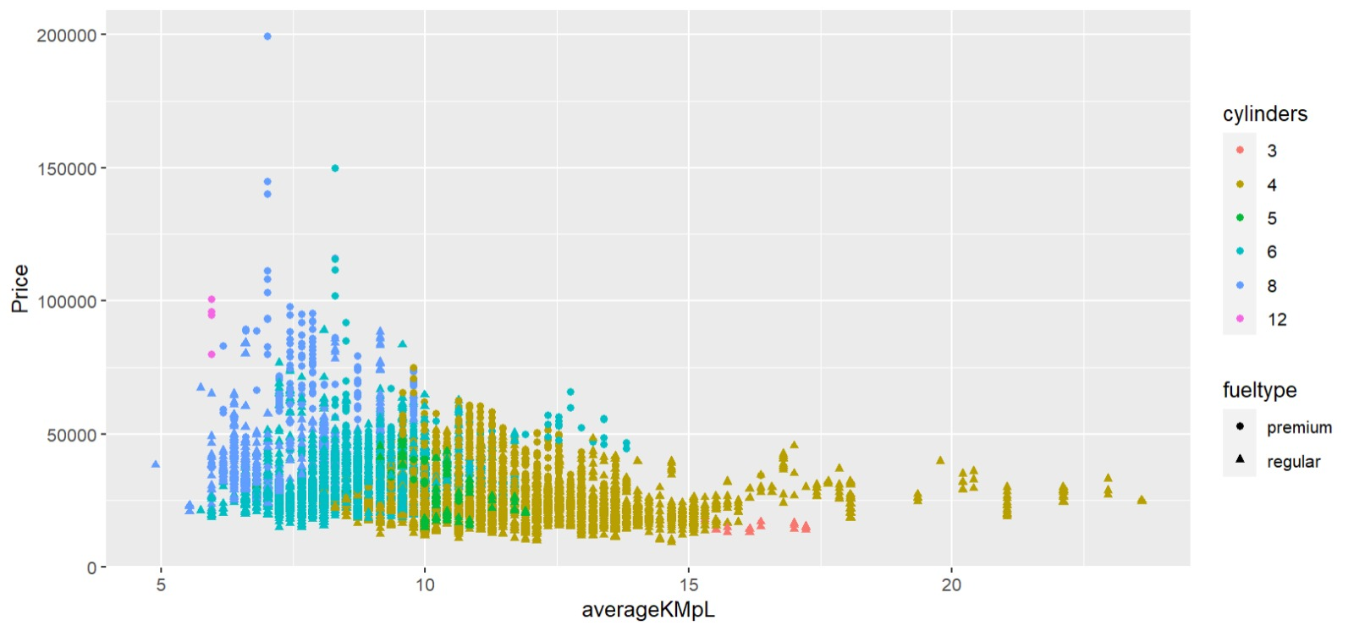
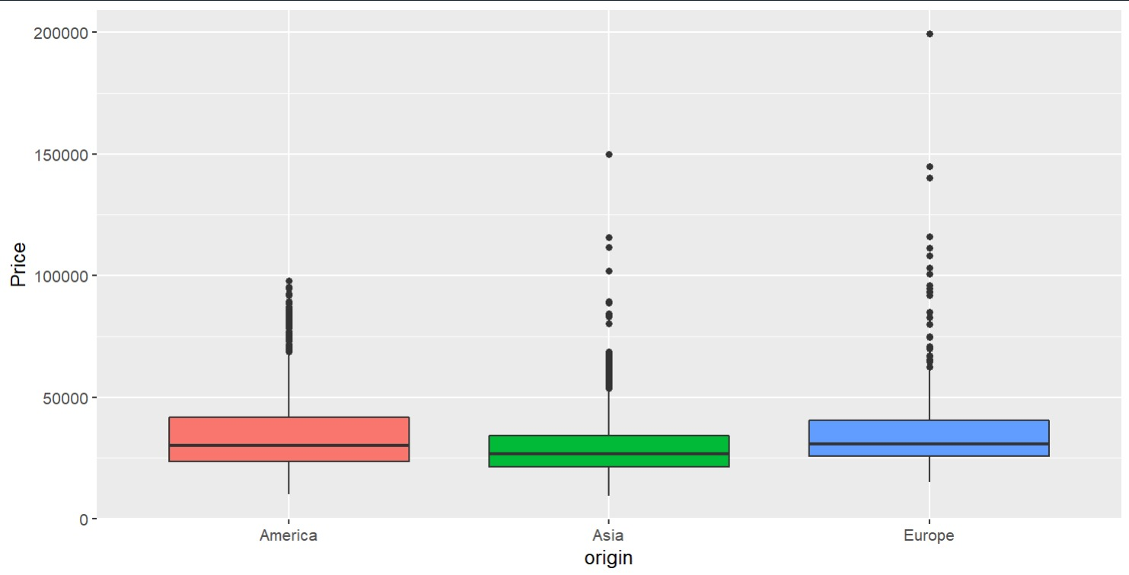
Exploratory Analysis (1)

Slide 4

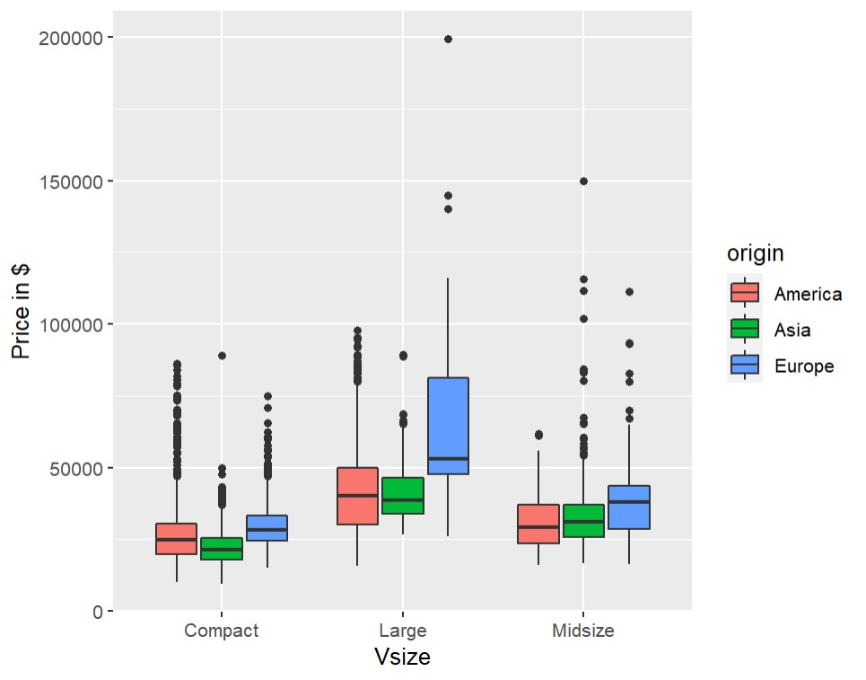
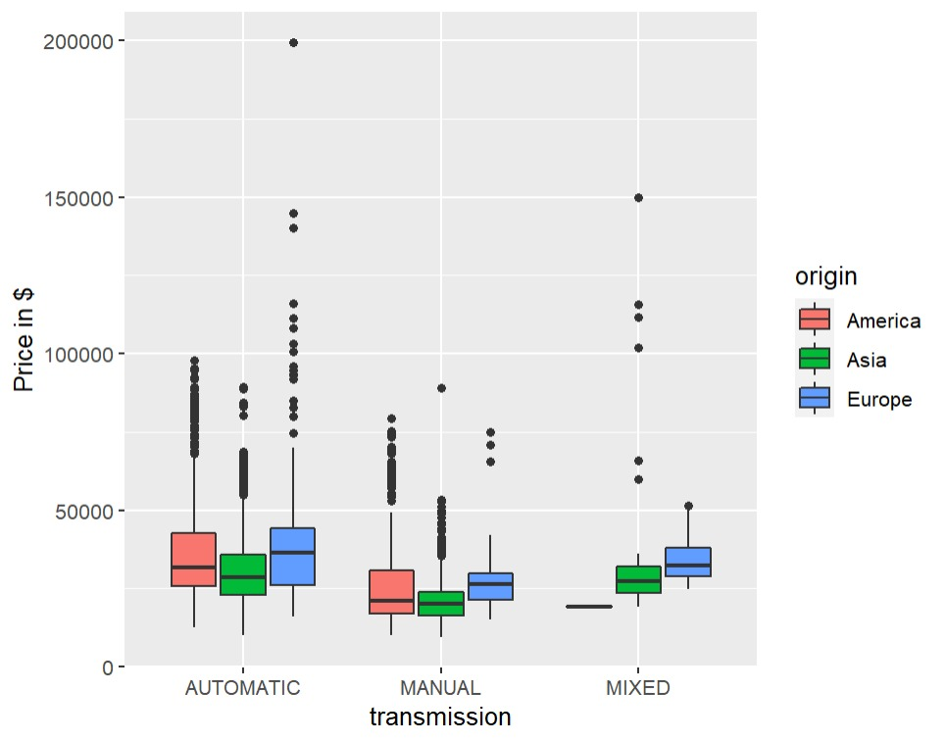
Exploratory Analysis (2)

Slide 5

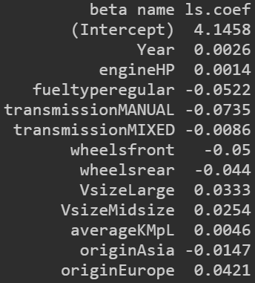
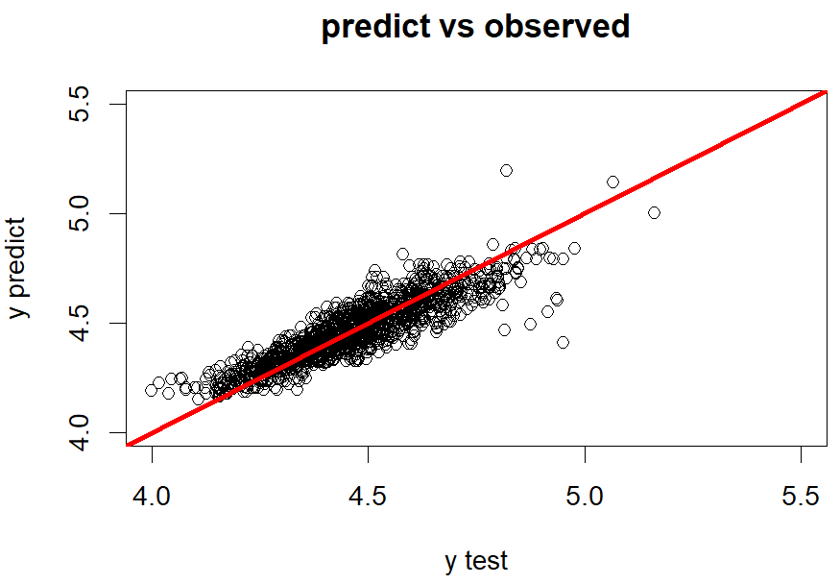

OLS Regression

Slide 6
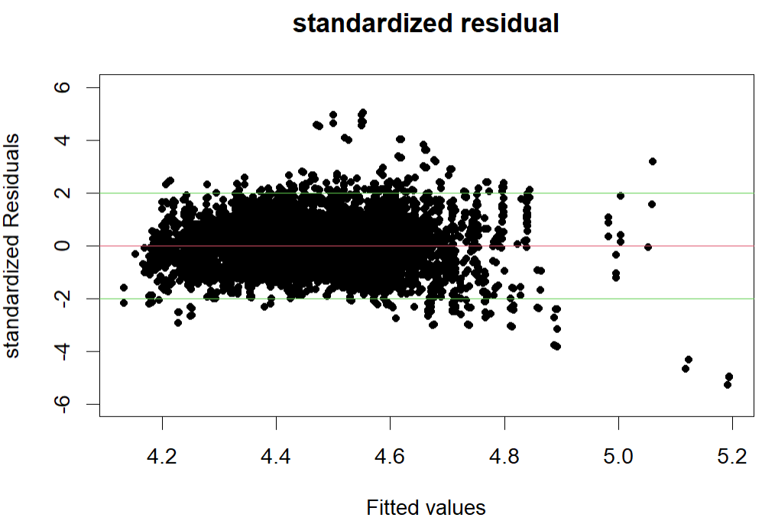
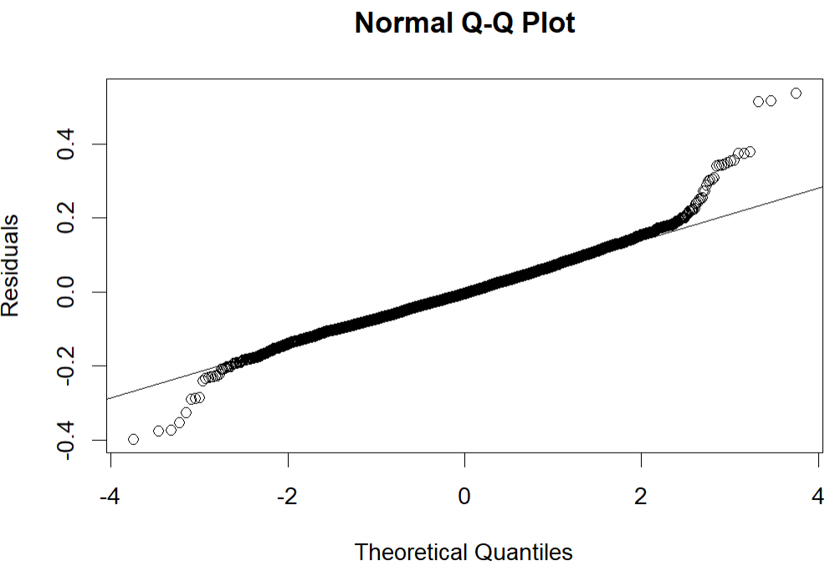
OLS Regression

Slide 7
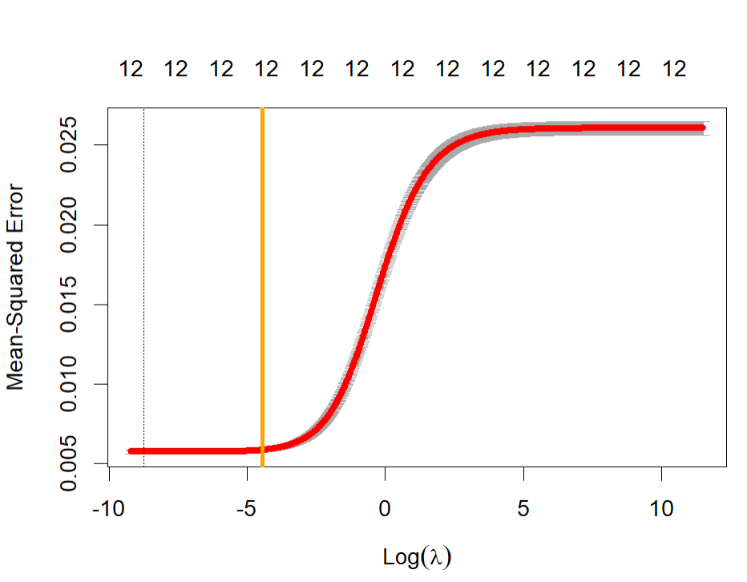
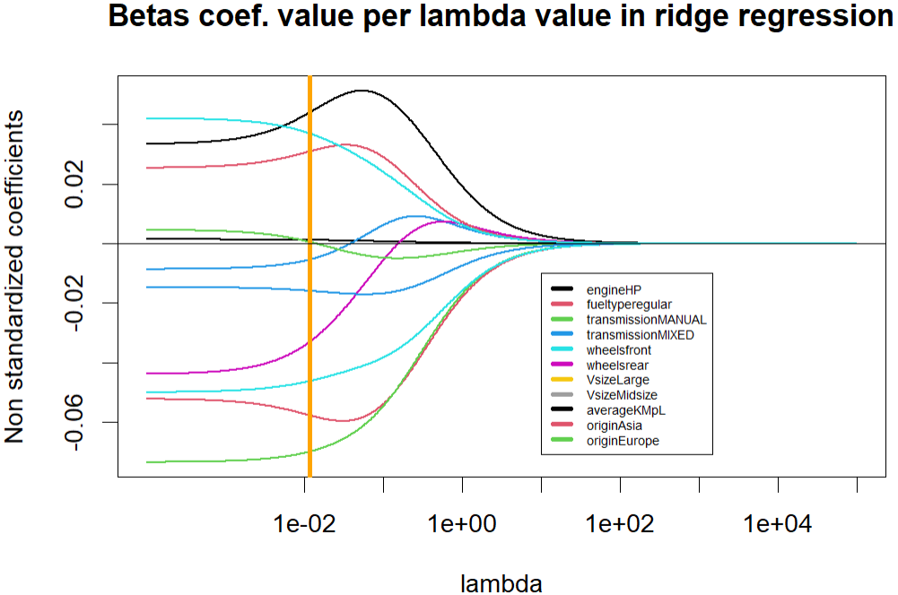
Ridge Regression
λ = 0.01514189

Slide 8
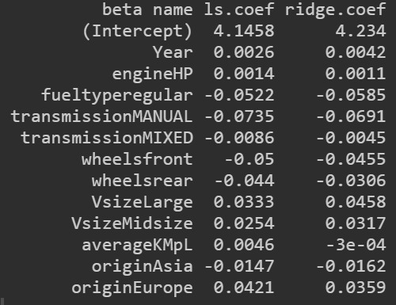
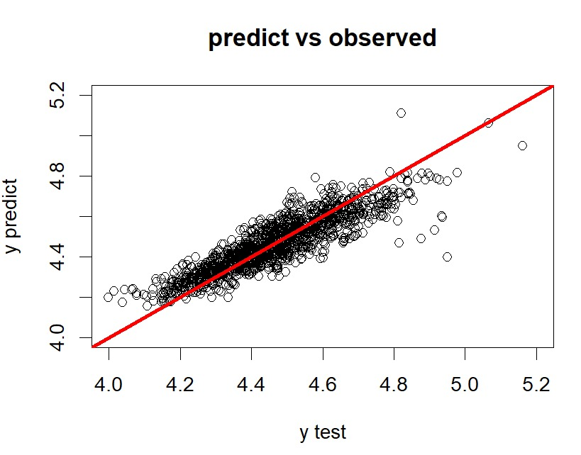

Ridge Regression

Slide 9
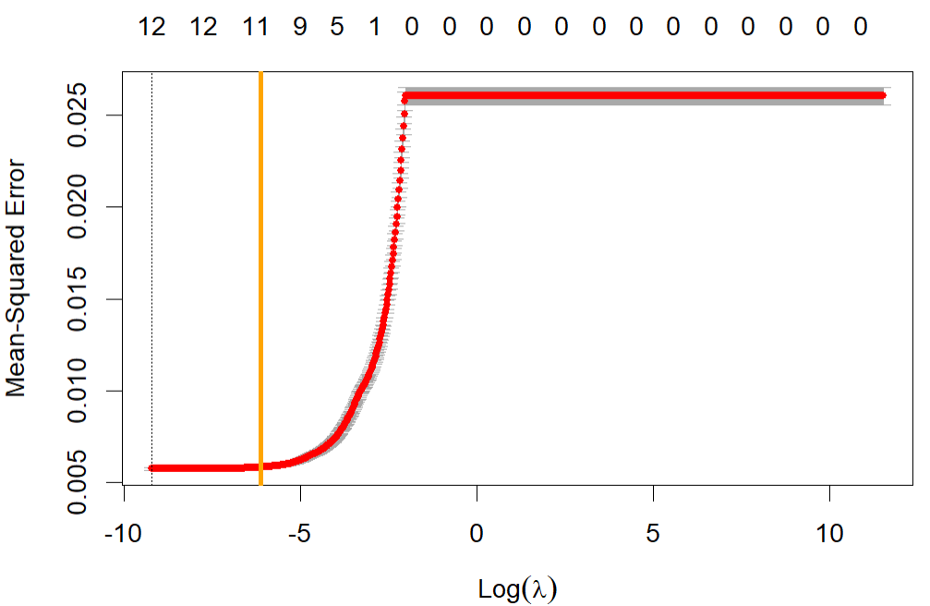
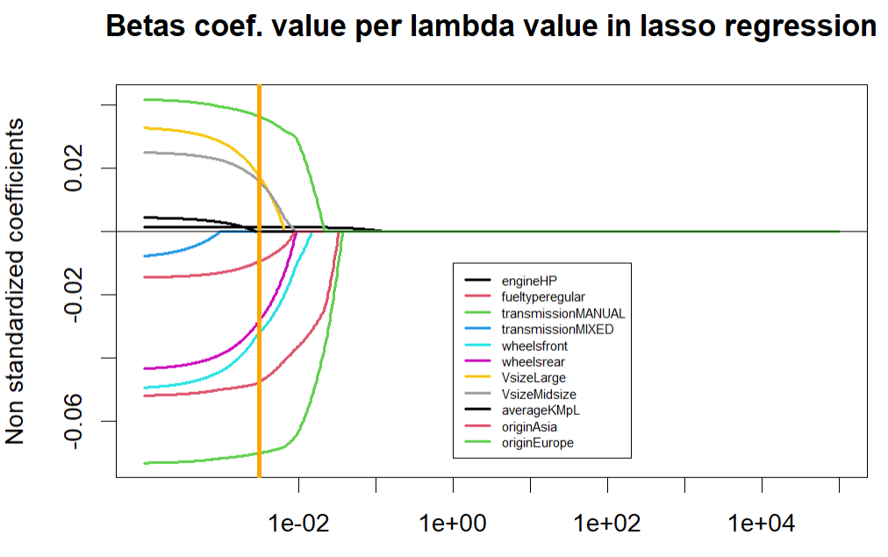
Lasso Regression
λ = 0.003065395

Slide 10
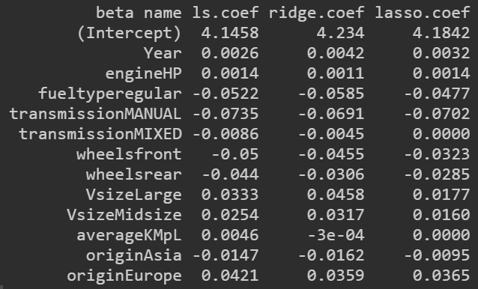
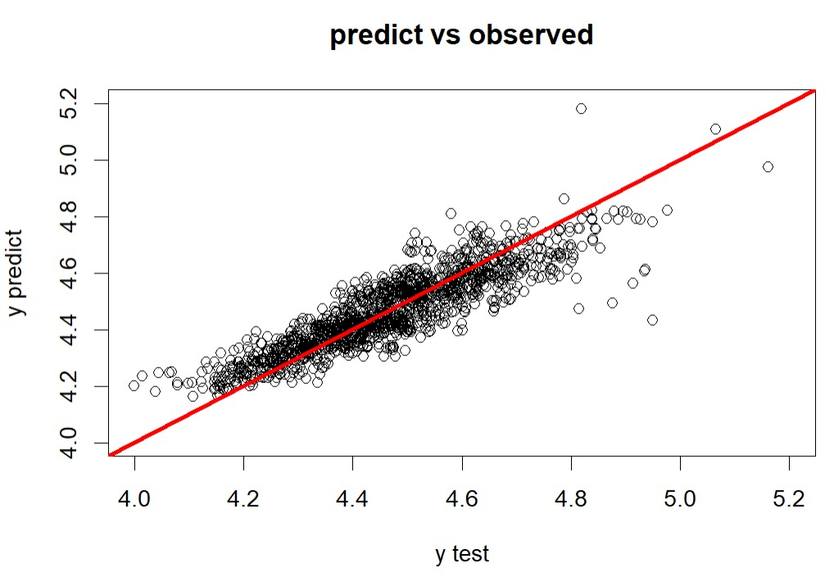

Lasso Regression

Slide 11
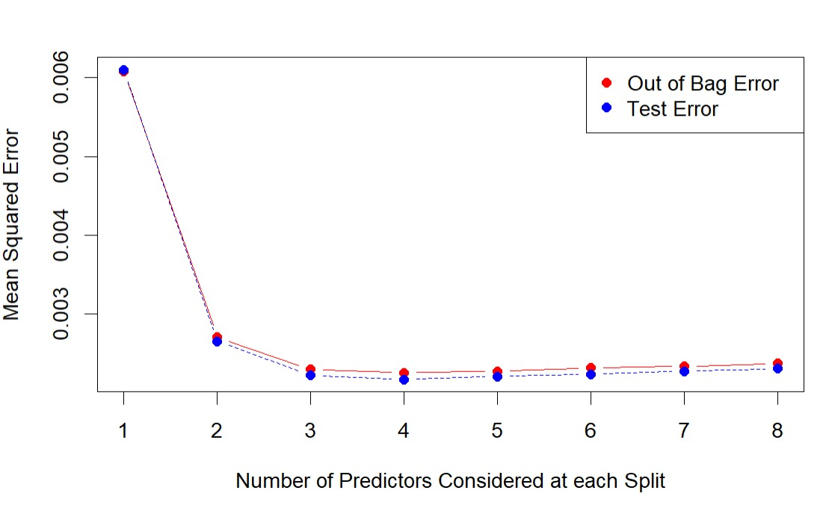
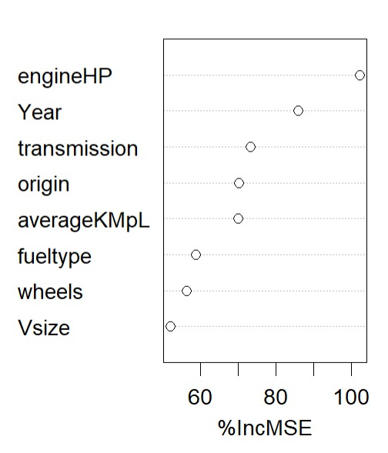

Random Forest

Slide 12
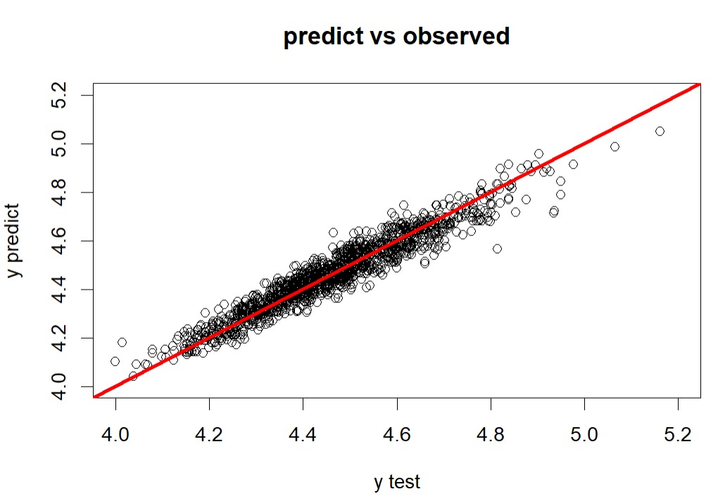

Random Forest

Slide 13
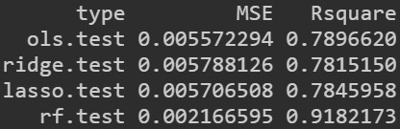
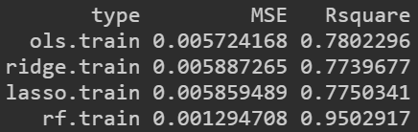
Conclusion
In conclusion we can state that Ridge and Lasso regressions results are very similar, while Random Forest method provides improved results in order to achieve our main goal.
As a matter of fact, looking at the data aside, it is clear that the Random Forest method is way more suitable for our aim.

